Slide 1
Strategy Research: Governance and Competence Perspectives
Williamson (1999)

Slide 2
The objectives of this article
• Compares two theoretical perspectives in business strategy, i.e., governance perspective and competence perspective.
• Answers some main challenges that the competence perspective brings to the governance perspective.
- Rebut some “mistaken” challenges
- Discuss some constructive challenges to direct some promising avenues for the future TCE research.

Slide 3
Comparison between governance and competence perspectives
The theoretical antecedents of the two perspectives:
Governance perspective: more on the economics side (transaction cost economic).
Competence perspective: more rooted in the organizational theory (e.g., behavioral theory of the firm, & evolutionary economics…) where the process is especially focused.
Precise Comparison: six key moves
(1) human actors, (2) unit of analysis, (3)describing the firm, (4)purpose served, (5) empirical progress, and (6) efficiency criterion)

Slide 4
Comparison between governance and competence perspectives
 | Governance Perspective | Competence Perspective
Human actor | Common ground: bounded rationality → incomplete contracting
 | Capacity to foresight: use ex-ante governance design to avoid ex-post hazards Opportunism: adverse selection, moral hazard, hold-up problems… (why contract is not self-enforcing) | Myopic: local search, learn from trial-and-error, and adapt through crises Absence of opportunism: although subgoals of individuals are mentioned, opportunism is eschewed.
Unit of analysis | Transaction (the three attributes of the transaction: frequency, uncertainty and asset specificity) | Blurred unit of analysis; “routine” as a promising candidate and akin to governance form

Slide 5
Comparison between governance and competence perspectives
 | Governance Perspective | Competence Perspective
Describing the Firm | Compares alternative modes of governance: firm vs market Contract law, incentive intensity, and administrative control → adaptive capacity (Williamson, 1991) The limitation of the firm → bureaucratic costs | A bundle of resources/routines, which consists of firm’s capability
Purposes served | Economize on bounded rationality and opportunism → min. transaction costs The discriminating alignment hypothesis: the match between the characteristics of transactions and the governance structures, leading to an economizing result (p. 1091) | Differential learning within and between firms ‘firms exist because they can more efficiently coordinate collective learning processes than can market organization (Foss, 1996c: 18).

Slide 6
Comparison between governance and competence perspectives
Using competence perspective to explain the existence, structure, and boundaries of the firm:
The principal factor is “the capacity of such an organization to protect and develop the competences of the groups and individuals contained within it, in a changing environment’ (Hodgson, 1998: 189).
Remaining question: why a unified firm (AB) is better or worse than in two autonomous firms (A and B)?
Potential answer from Liebeskind (1996): when property rights for knowledge are weak, a unified firm can mitigate knowledge leakage. → The comparative institutional action resides in interfirm and intrafirm differences in the mechanisms of governance (transaction cost reasoning).
Related question: the boundaries of the firm
→ Suggests a complementary relationship between governance and competence perspectives

Slide 7
Comparison between governance and competence perspectives
 | Governance Perspective | Competence Perspective
Empirical | In progress (survey data) | The definition of core competence: ex-post rationalization to tell a success story; → How to operationalize core competence?
Efficiency criterion | No hypothetical ideal form of organization Conceptual move with operational significance: extant condition is presumed to be efficient due to the remediableness criterion. | Dynamic efficiency and somewhat inefficient • Learning and innovation • Path dependent

Slide 8
Answers to “mistaken critiques”/challenges of TCE
Opportunism does not have the organizational consequences that have been ascribed to it.
- The differences among alternatives of governance form (incentive, control, and contract law) will vanish if opportunism is zeroed out.
(2) Transaction cost is a static concept and needs to be made dynamic.
- Governance structures are predominant instruments for adaptation.
- TCE engages many intertemporal issues: timely adaptations and timely convergence, and the “fundamental transformation”.
(3) Governance does not engage the issues of management.
- Significant provision for management → firm is described as a syndrome of ‘managerial’ attributes
e.g., informal organization as a factor that supports added compliance and cooperation within firms.
- Implication: to include more cognitive specialization.

Slide 9
Constructive critiques and research opportunities
Beyond Piecemeal
• Incorporate technological non-separability.
• The interaction effects of different transactions.
• The firm in its entirety is different from and larger than the sum of parts.
Beyond generic governance: strategy
• Transaction cost economics informs the generic decision to make-or-buy while competence
brings in particulars.
• Introduce firm heterogeneity and industry structure (core competence, market niches, and rivalry).
Learning under comparative institutional perspective
• Learning through experience: between the foresight and myopic tendencies (ignore the long run, ignore the larger picture, and overlook failures).
• Learn to contract → learning influences the intertemporal governance choice calculus.

Slide 10
Questions:
• Williamson (1999) regards TCE as a generic decision to make-or-buy while competence brings in particulars. Why not the opposite? Can we regard competence perspective as generic and TCE as particular?
For example, in terms of vertical integration, small firms may realize that hierarchy is a more efficient governance structure than market. However, they must get stick to the status quo because they do not have resources/capability to merge. In this way, can I argue that having the option to choose make-or-buy is a ramification of competence?
• Can transaction cost economics set a boundary for firms to accumulate specialized investment?
Competence perspective suggests that with specialized investment/resource, firms can gain competence. However, in the combination of environmental change and resource dependence, the accumulation of (prior) specialized investment may impede the firm’s ability to adapt. Then, can TCE, which focuses on adaptation, help answer what is boundaries for such an accumulation?

Slide 11
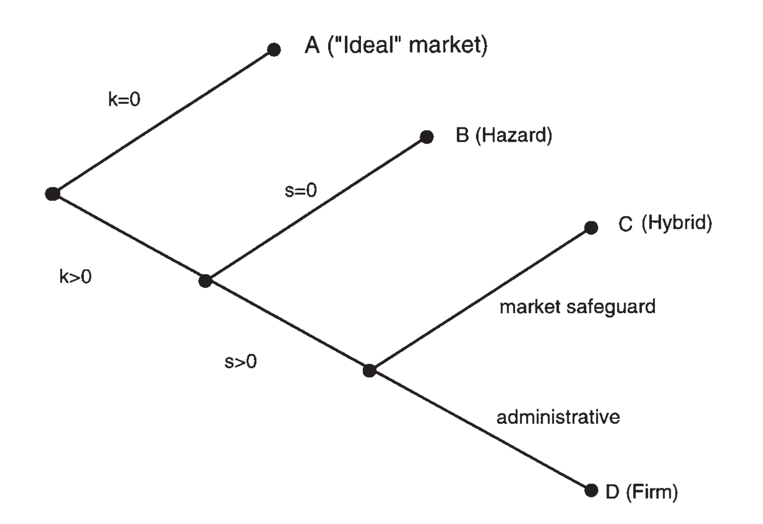
Simple contracting scheme
no specific investment
no safeguard features
transaction specific investments
safeguard provision
(Williamson, 1999: p. 1091)
Back

